Slide 1
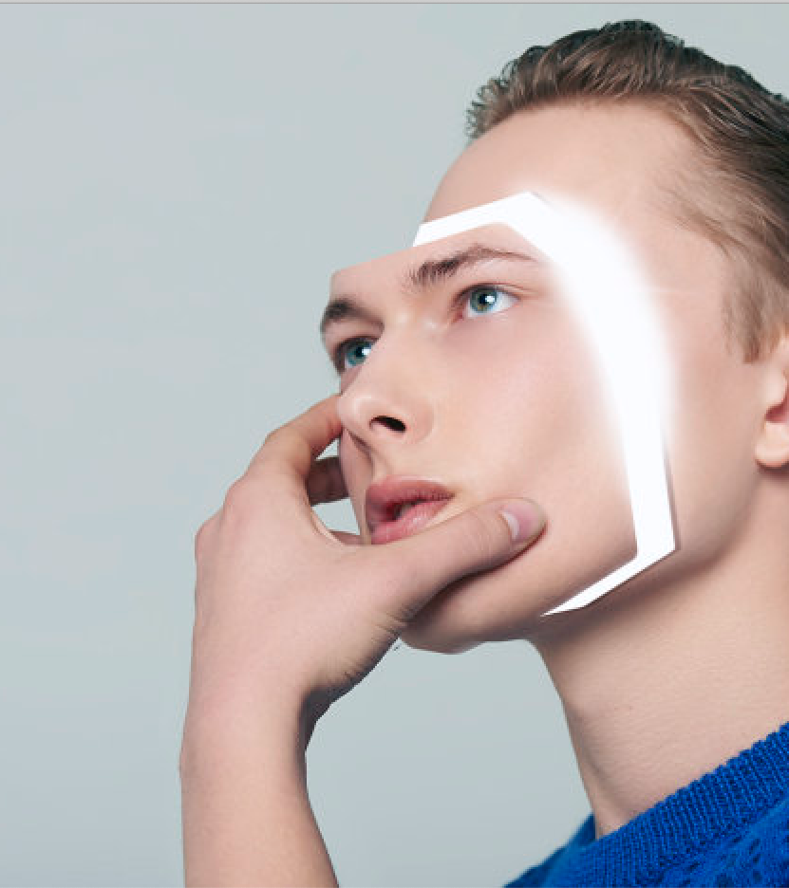
Real or Reel? The Bane of Deep Learning!
CMPE 202 – Deep Learning
Arpitha Gurumurthy
014642290
Research Paper reference:
DeepFakes and Beyond: A Survey of Face Manipulation and Fake Detection
https://arxiv.org/pdf/2001.00179.pdf

Slide 2
Seen a politician say things they couldn’t have ever said or your favorite film actors in pornographic movies?
Well then, you have seen a “DeepFake”. Call it an advanced 21st century Photoshop!

Slide 3
Why has it become so common?
Easy access of large-scale public databases
progression of deep learning techniques that eliminate many manual editing steps – Autoencoders and GANs
Applications such as FaceApp and ZAO allow even amateurs in the field to create fake images and videos

Slide 4
What IS A DEEPFAke?
Deep learning-based technique to create fake images/videos by swapping a person’s face with that of another person
The term originates after a reddit user who claimed to have turned celebrity faces into porn videos in late 2017.
Positive use cases:
education (more interactivity), video gaming and 3D modelling industries
Negative use cases:
Pornography, financial fraud, politics, hoaxes, fake news and many more

Slide 5
How was it traditionally?
Firstly, the number of face manipulations were limited lack of sophisticated tools and the complex steps it involved.
Fake detection methods back then were based on in-camera and out-camera fingerprints
These methods hugely relied on training scenarios and did not serve accurate results under unobserved conditions.
In today’s world where fake images look too real, the robustness of fake detection techniques is of utmost importance.

Slide 6
Are fake detection Methods A 100% foolproof?
We are yet to reach a stage where fake detection is 100% foolproof
Fake images when uploaded to social media & websites are subject to compression, noise, resizing and other changes.
This makes it difficult for detection algorithms to work, since they are trained only for specific scenarios.

Slide 7
Facial Manipulation Techniques
4 most common types of Facial Manipulation Techniques
1. Entire Face Synthesis
2. Identity Swap
3. Attribute Manipulation
4. Expression Swap
Other less common facial manipulation techniques include Face Morphing, Face De-Identification & Face Synthesis

Slide 8
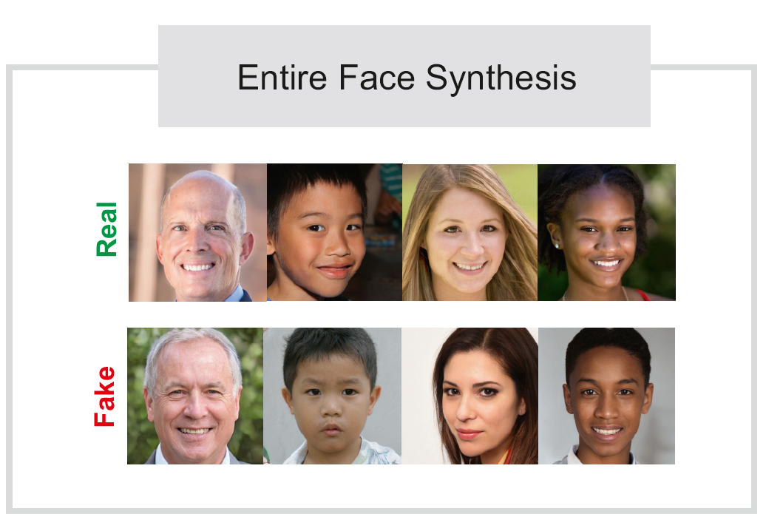
1. Entire Face Synthesis
Creation of a brand-new face from scratch
Excellent quality face with high degree of realism
Video games & 3D modelling industries find it very beneficial
Negative consequence: Very realistic social media profiles for misuse

Slide 9
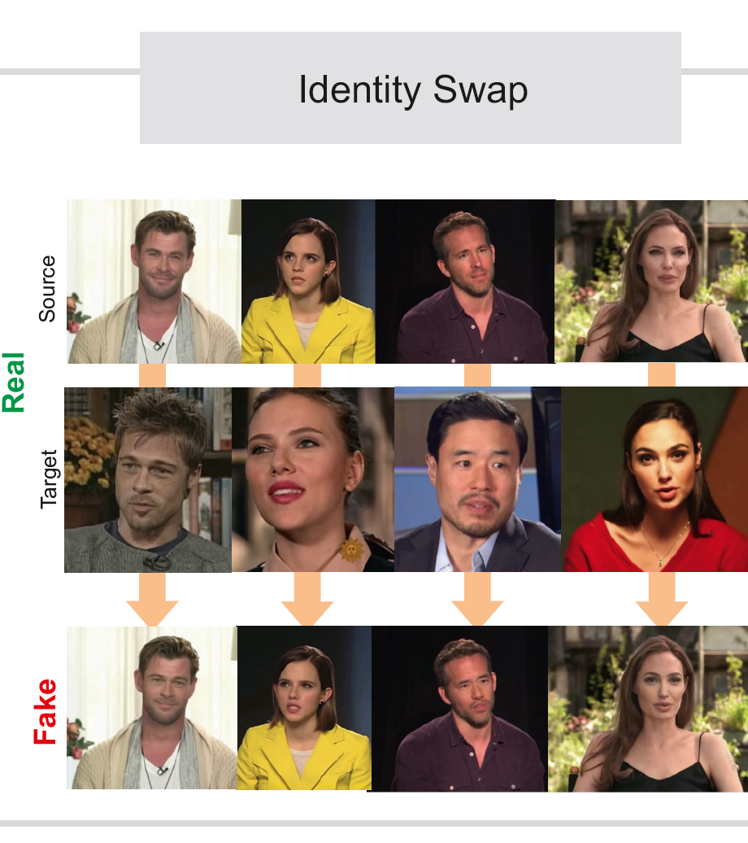
2. Identity Swap
Swapping the face of one person with another
This technique benefits the film industry
Negative consequence: Celebrity pornography, hoaxes, financial fraud, politics

Slide 10
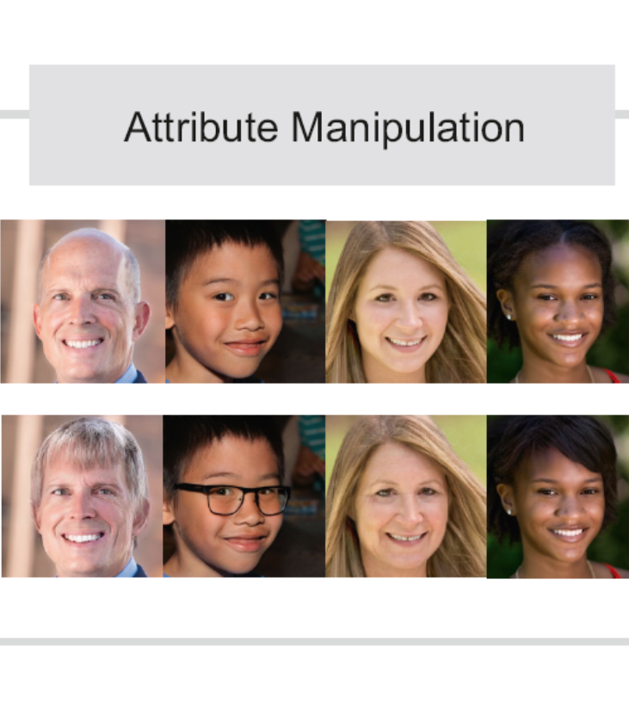
3. Attribute Manipulation
Modifies facial attributes – hair color, skin, gender, age etc.
Also known as Face editing or Face Retouching
Commonly used in FaceApp mobile app
Negative consequence: False advertizements

Slide 11
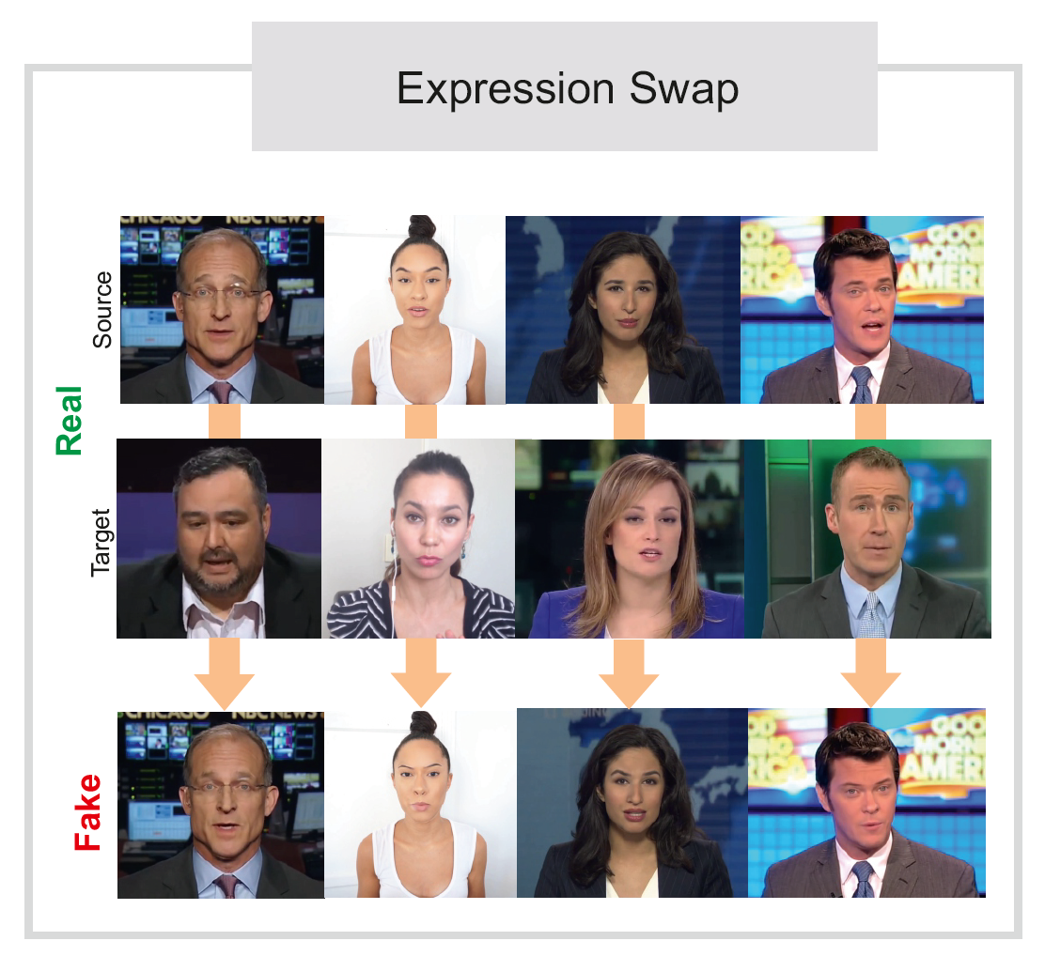
4. Expression swap
Involves modifying the facial expressions of a person.
This is also known as Face Re-enactment model.
Seen the popular video of Mark Zuckerberg saying, “total control of billions of people’s stolen data”, that he never said?
Such are the dangerous consequences of Expression Swap.

Slide 12
Detecting Facial Manipulation

Slide 13
1. Entire face Synthesis DETECTION

Slide 14
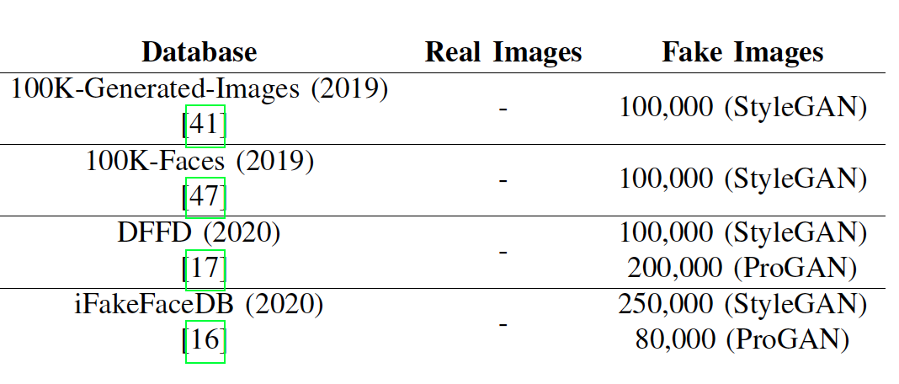
Data and manipulation techniques
Some techniques analyzed the internal GAN pipeline in order to detect the differences between real and fake images while some others prioritized the color differences.
An approach called “FakeSpoter” – captured the neuron behaviour. The neuron activation patterns between different layers help record hidden features important for manipulation detection. For classification, the researchers mostly used KNN, SVM and LDA.
Attention methods were also employed to further up the detection process. The best results were obtained by using CNN with attention mechanisms. The researchers used CNN models like XceptionNet and VGG 16 achieving a 100% AUC and 0.1% EER.

Slide 15
Note about iFakeFaceDB
A point worth noting is that the iFakeFaceDB database is an updated version of previous fake image databases in which GAN fingerprint has been removed using an approach called GANprintR making this a hard problem to solve. The best achieved EER was 4.5% even using the most remarkable fake detectors.

Slide 16
2. IDENTITY SWAP

Slide 17
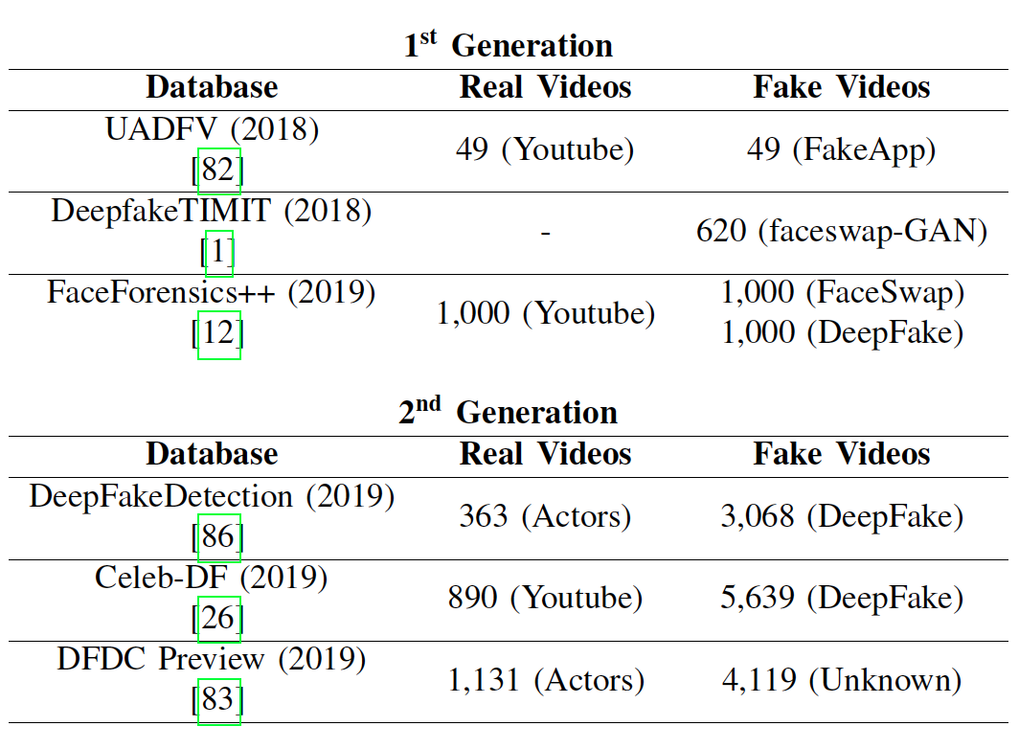
DATA
The key takeaways for differences between the first- and second-generation databases —
The fake content/videos from the first-generation databases have:
low quality images,
color contrast between the synthetic face mask and the skin color,
visible boundaries of the fake mask,
visible elements from the original video, among others.
They also have limited scenarios with respect to camera position and light conditions.
Most of these flaws have been fixed in the videos of second-generation databases making them more challenging to detect.

Slide 18
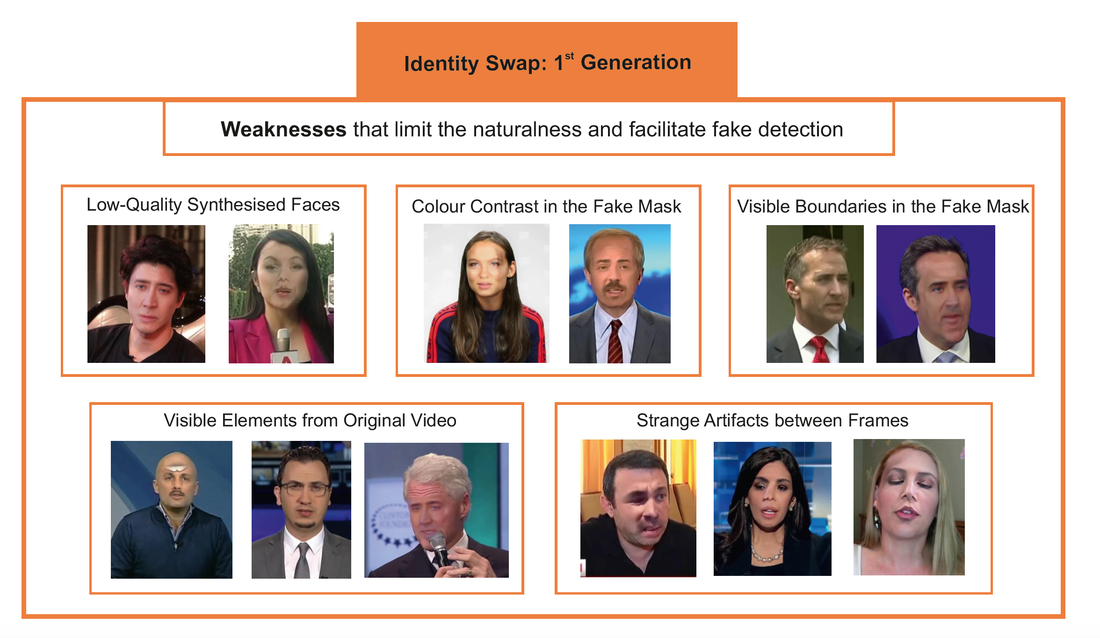
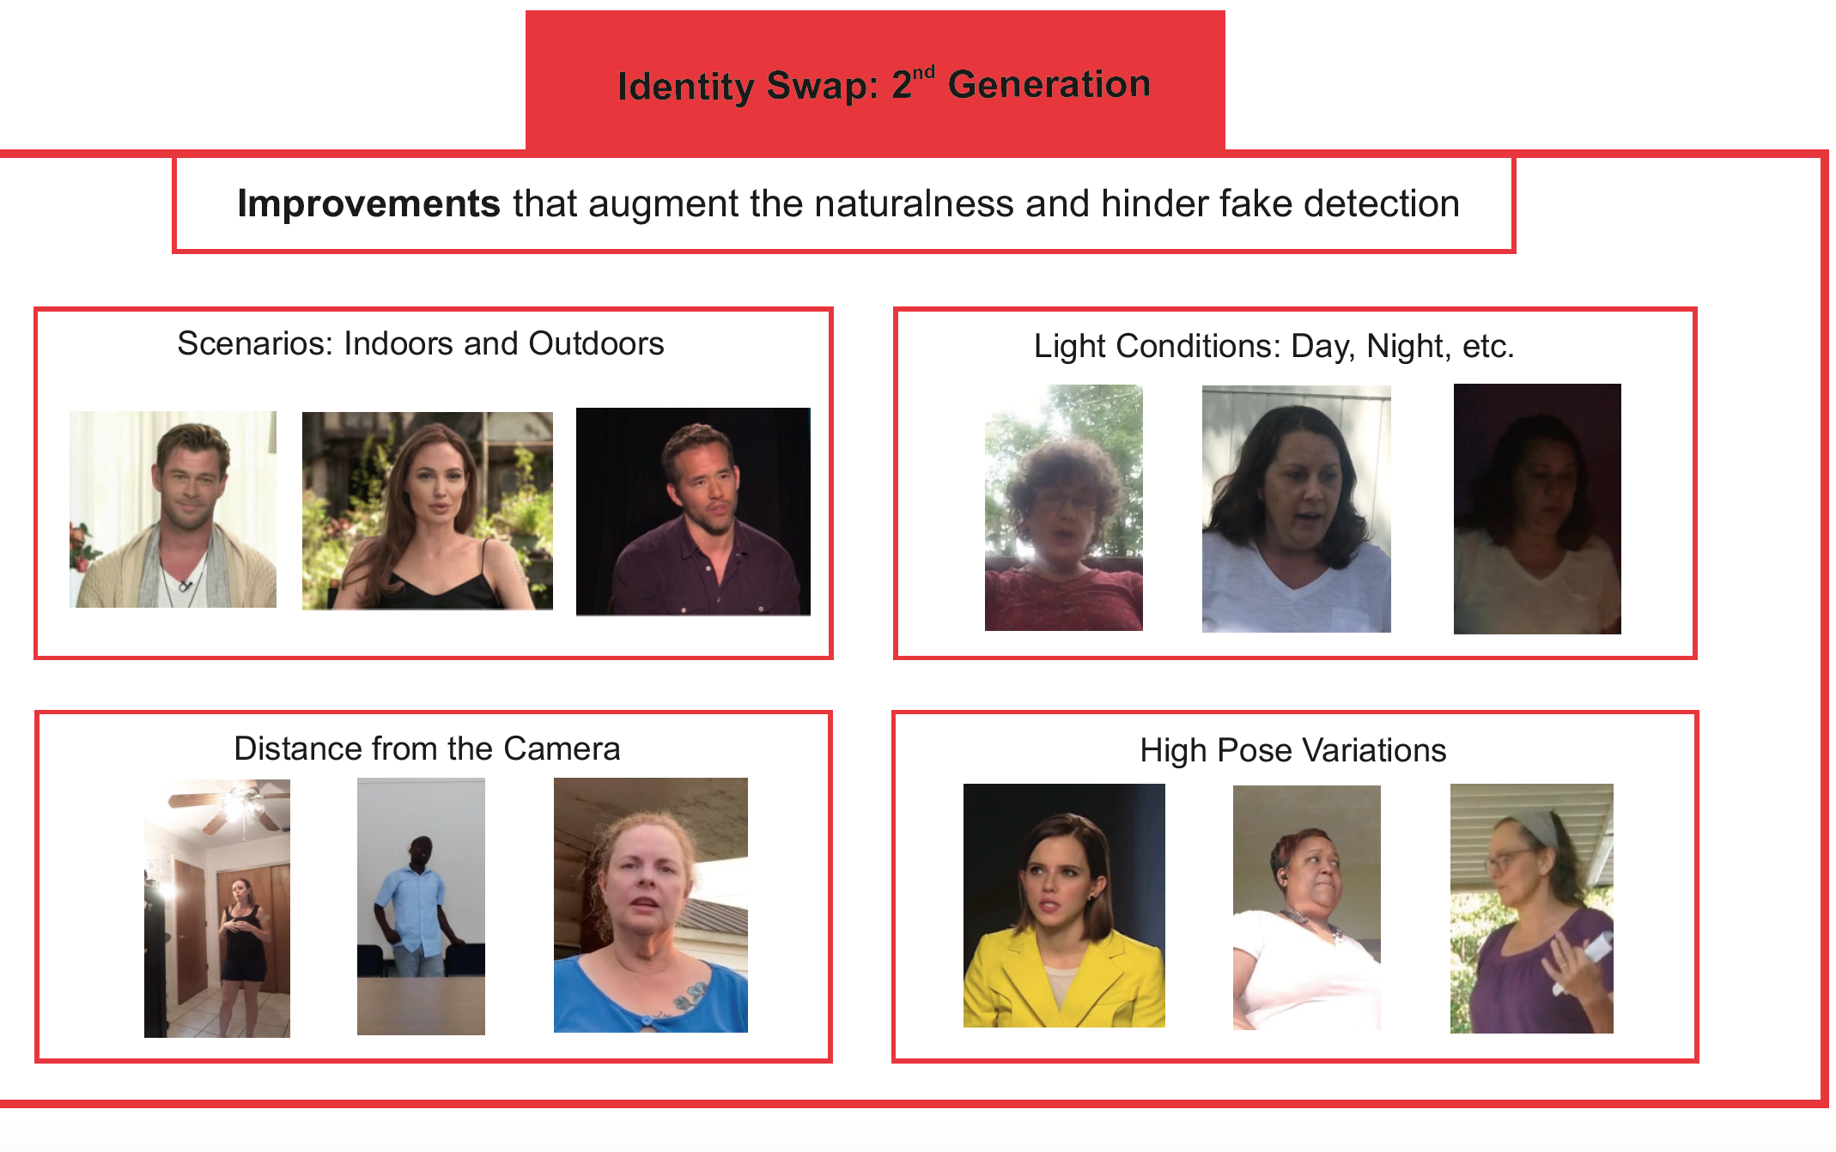

Slide 19
Approaches used to detect fake videos include –
Recording inconsistencies between lip movement and audio, Mel-Frequency Cepstral Coefficients (MFCCs) were taken as audio features and distance between the lip landmark for the visual features. PCA for dimensionality reduction and RNNs based on LSTM were employed to detect fake videos.
Simple visual features such as eye color, missing reflections, missing elements between eye and teeth areas were used with Logistic Regression and MLP.
Some other approaches employed features such as facial expressions and head movement, Deep-Vision considered eye blinking patterns between the real and fake images.
Another approach worth mentioning is based on mesoscopic and steganalysis features which achieved an accuracy of 98.4% and was considered for the best performance. It was also tested against unseen data and proved to be robust.
Manipulation techniques

Slide 20
3. Attribute manipulation

Slide 21
Attribute
Manipulation
DATA
Since the code for GAN approaches required to create attribute manipulated images are openly available, the researchers can employ these techniques to create fake database on a need basis. And as for the readily available database, DFFD is the only known one for this detection.
MANIPULATION DETECTION
Most of the approaches are like the ones stated in the entire face synthesis section. Additionally, many deep learning methods were tested that achieved good results.
The best performing approach used attention mechanisms to improve feature maps of CNN models. Here, 2 data sources for fake images were considered — one from images from FaceApp software and the other from starGAN. When tested against DFFD database, it achieved 99.9% AUC and 1.0% EER.

Slide 22

4. Expression Swap
DATA:
The only known database for fake content under this technique is FaceForensics++.
MANIPULATION TECHNIQUES:
Intuitively this technique sounds very similar to the identity swap. Hence, most of the detection techniques are very similar to what we’ve discussed for identity swap.

Slide 23
Other less common face manipulation detection techniques

Slide 24
1. Face Morphing
A type of facial manipulation system which can create an artificial biometric face sample resembling biometric information of two or more individuals.
This is a serious threat wrt facial recognition systems.
Although face morphing detection research is faced with a number of challenges and is still in infancy, a “Morphing Attack Detection” research paper has provided some hope.

Slide 25
2. Face De-Identification
This method removes all identity information from an image or video, thus protecting the privacy of the person in context.
This is achieved in several ways. The first method is by blurring or pixelating the image.
And other methods involve adding different identities to face images by maintaining all other factors like pose, expression, and illumination unchanged.
One possible option to achieve face de-identification could be through face identity swap.

Slide 26
3. Face Synthesis (Audio to Video & Text to Video)
This type of video manipulation is also known as lip-sync deep fakes.
Obama’s famous video is an accurate example of Audio to Video Face Synthesis.
The approach uses several hours of old videos along with a new audio recording as input and a recurrent neural network (LSTM in this case). Using which, mapping from raw audio features to mouth shapes are learned. Then, a new video is created based on mouth shape at each frame, mouth texture and 3D pose matching.
For the second type, that is synthesis of fake videos from text, a video of a person speaking and text to be spoken are taken as input. Then a new video is synthesized with the persons mouth synchronizing with new words.

Slide 27
CONCLUSIOn
Entire Face synthesis – more research is needed in order to detect fake content in “iFakeFaceDB”, when GAN fingerprints are removed.
Identity Swap: The approaches work great in detecting fakeness when the patterns are similar to the training data, but not so well ‘in the wild’.
Attribute Manipulation: same aspect highlighted for the face synthesis. In addition to limited databases.
Expression Swap: Yet again the scarcity of databases in a problem. The only known one being ‘FaceForensics++’

Slide 28

On a closing note, it is important for each of us to familiarize ourselves with the DeepFake techniques and the existence of fake content itself to do whatever little we can to prevent it from circulating and causing harm to the society.

Slide 29
THANK you!
I would like to thank my Professor Vijay Eranti for inspiring me to research on DeepFakes and understand its implications.

